Slide 1
Ansible Commands

Slide 2

Agenda
Introduction to Ad-Hoc Commands
Gathering Facts
Shell Commands
File Transfer
Managing Packages
Users and Groups
Managing Services

Slide 3

Introduction
An ad-hoc command is something that you might type in to do something really quick, but don’t want to save for later.
Good place to start to understand the basics of what Ansible can do prior to learning the playbooks language.
Can also be used to do quick things that you might not necessarily want to write a full playbook.

Slide 4


Ansible Adhoc
Create an empty file
Delete an empty file

Slide 5
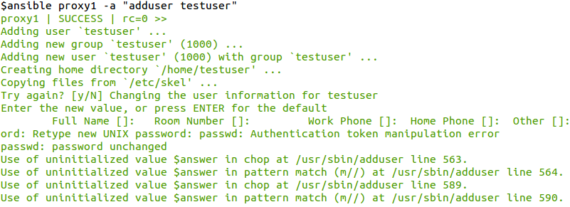

Ansible Adhoc
Add a user
Delete a user

Slide 6


Ansible Adhoc
Add a group
Delete a group

Slide 7
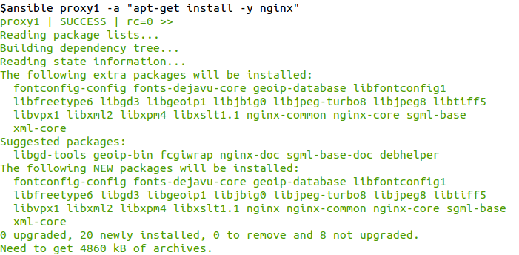
Ansible Adhoc
Install a Package

Slide 8

Ansible Adhoc
Check service status
Start service
Stop service

